Slide 1
A Commercial Nocturnal Asthma Monitor
William Padovano David Kim Chris Beyer
Group 26

Slide 2
Need and Scope
Need: Nocturnal Asthma (NA), or a nighttime exacerbation of asthma symptoms, affects an estimated 47-75% of the several hundred million asthmatics worldwide. There is currently no objective, home-based monitoring system for nocturnal asthma.
Scope: To build a commercial, home-based device capable of continuously monitoring symptoms and alerting parents or caregivers if intervention may be required (i.e. during an asthma exacerbation).

Slide 3
Design Requirements
Hardware specifications | Metrics
Sampling rate | 44,100 samples/second
Recorded audio frequency range | Up to 20 kHz
Minimum single core CPU speed | 400 MHz
Minimum SDRAM size* | 512 MB
Minimum SDRAM read/write speed | 400 MHz
Power supply requirements | 3W - 10 W at 5 V
Transmitter open field range | 300 m
Operating noise | Below 30 dB (inaudible)
Software specifications | Metrics
Read rate | 44,100 samples/sec
Allowable processing delay | Less than 50 ms
Computations | Must perform Fast Fourier Transforms
Enclosure specifications | Metrics
Length x width x depth | 113 mm x 97 mm x 58 mm
Weight (prototype) | 240 g
Prototype parts list:
Raspberry Pi 512 B+ 512 MB ------------ $35
Microsoft LifeCam Cinema Webcam --- $60
Adafruit 4 digit 7 segment display ------ $15
White LED and Red LED -------------------- negligible
3D printed ABS plastic enclosure -------- negligible
Total cost: $110

Slide 4
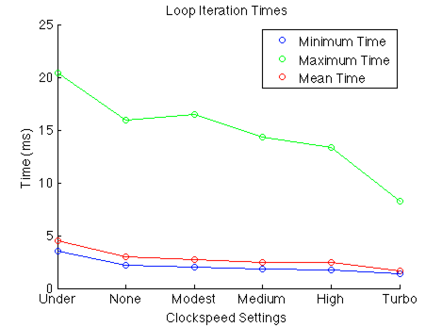
Specific Details: clock speeds and run time
Name | CPU (MHz) | GPU (MHz) | SDRAM (MHz) | Run success
Underclock 1 | 200 | 200 | 200 | No
Underclock 2 | 200 | 200 | 400 | No
Underclock 3 | 400 | 200 | 200 | No
Underclock 4 | 300 | 200 | 300 | Error during run
Underclock 5 | 400 | 200 | 400 | Yes
None | 700 | 250 | 400 | Yes
Modest | 800 | 250 | 400 | Yes
Medium | 900 | 250 | 450 | Yes
High | 950 | 250 | 450 | Yes
Turbo | 1,000 | 500 | 600 | Yes

Slide 5
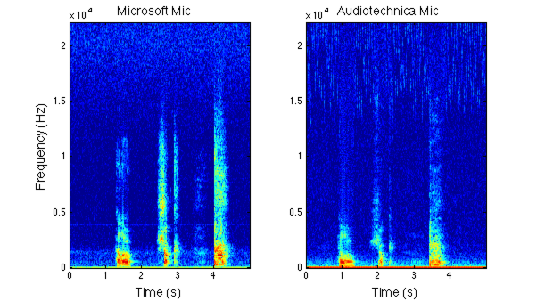
Specific Details: Microphone
Must detect frequencies up to 20 kHz
Audiotechnica Microphone:
Frequency range of 50 – 13,000 Hz
Microsoft LifeCam Cinema Microphone:
Frequency range of 200 – 8,000 Hz +- 4 dB
Microsoft Microphone was chosen

Slide 6
Flowchart
Continuously collect audio data
Continuously analyze frequency content
Determine if a sound event was a cough
Send alarm if dangerous cough number of coughs per minute

Slide 7
Cough signals
It is easier to distinguish coughs by looking at frequency content than intensity.

Slide 8
Software Description: Frequency Screening
512 samples (11.6 ms) of audio are weighted by a Hamming window function and the FFT is taken.
Power in three frequency bands are examined and, if above threshold, FFT is added as a column into a growing spectrogram
8.5 kHz +- 100 Hz
6.8 kHz +- 100 Hz
1.2 kHz +- 100 Hz
Clap blue ships sail soft cough loud cough

Slide 9
Software Description: Frequency screening
FFT from chunk 1
FFT from chunk 2
Spectrogram of audio event
Power
Power
Bins
Bins
Power in each bin
Power in each bin
. . .
50 ms of audio data that does not pass frequency screening

Slide 10
Software Description: Template Creation
Continuously records audio and saves all sound events that have power significant power in the three frequency bands
Each spectrogram is cut to the duration of the shortest spectrogram
The spectrograms are then averaged, to produce a cough template

Slide 11
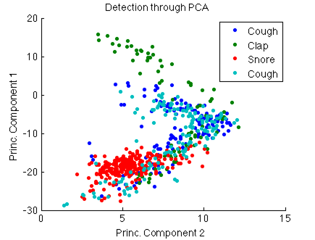
Software Description: Template Matching
Tried PCA, cross-correlation, simple difference, and scalar projection
Principle component analysis
Difference between template and new sound event

Slide 12
Software Description: Template Matching
For scalar projection, the template and new event spectrograms are flattened into 1D arrays. The new event array unit vector is projected onto the template array unit vector. The closer to 1 the better.
For the standard deviation method, the difference matrix is flattened and the standard deviation is taken. The closer to 0 the better.
Sound event | Scalar Projection | Standard Deviation
Cough 1 | 0.9313 | 0.7687
Clap | 0.7551 | 1.3723
Snore | 0.8299 | 1.0629
Cough 2 | 0.9259 | 0.7987
Sound event comparison | Scalar Projection Rel. Error | Standard Deviation Rel. Error
Cough 1 – Cough 2 | 0.58% | 3.9%
Clap - Cough | 11% | 75%
Snore - Cough | 19% | 35%

Slide 13
Software Description: Cough Frequency
After difference is taken with template, if standard deviation is below threshold, then the sound event is registered as a cough. This blinks the white LED and adds a value to the display.
If there are more than 20 coughs/minute, then the monitor signals an alarm. In the actual device, this would be a radiofrequency signal to a receiver at the parent’s bedside. In the prototype, the red LED lights up.

Slide 14
Conclusions: Performance
Sensitivity and specificity assessed in 4 tests. The first was in a quiet room, the second was during a conversation, the third was during a conversation while watching TV, and in the fourth the participant coughed in a pillow
Minimum cough intensity in dB that can be detected by monitor:
Test Number | Coughs detected | False positives
Quiet room | 38/38 | 0
Conversation | 18/18 | 1
Conversation with TV | 21/21 | 4
Coughing into pillow | 18/24 | 0
47 dB 51 dB 59 dB 62 dB 66 dB

Slide 15
Conclusions: Improvements
Lower minimum cough intensity threshold
Do preliminary frequency scanning with band-pass filters
Constantly update the cough template throughout use

Slide 16
Conclusions: IP and marketing
File a utility patent for the cough monitoring device
Apply for a registered copyright on software
Could potentially need FDA approval
Estimated total market size: around 950, 000 children in the United States
Number of children with parents that might be concerned about nocturnal asthma
Percentage of those families that have disposable income to afford device

Slide 17
Questions?

