Slide 1
A Commercial Nocturnal Asthma Monitor
Group 26
David Kim, William Padovano, Chris Beyer
October 27th, 2014

Slide 2
Need
What is nocturnal asthma (NA)?
  Nighttime exacerbation of asthma symptoms
  Indication of improper management of asthma
Affects 47-75% of all asthmatics
Consequences:
  Depression
  Anxiety
  Developmental, emotional, and behavioral problems
Need ● Scope ● Design Requirements ● Alternatives● Analysis ● Specific Details

Slide 3
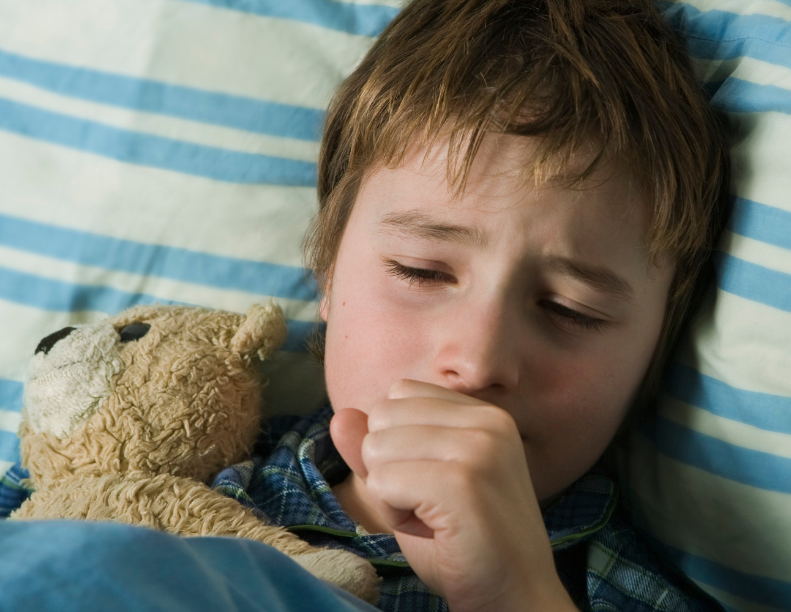
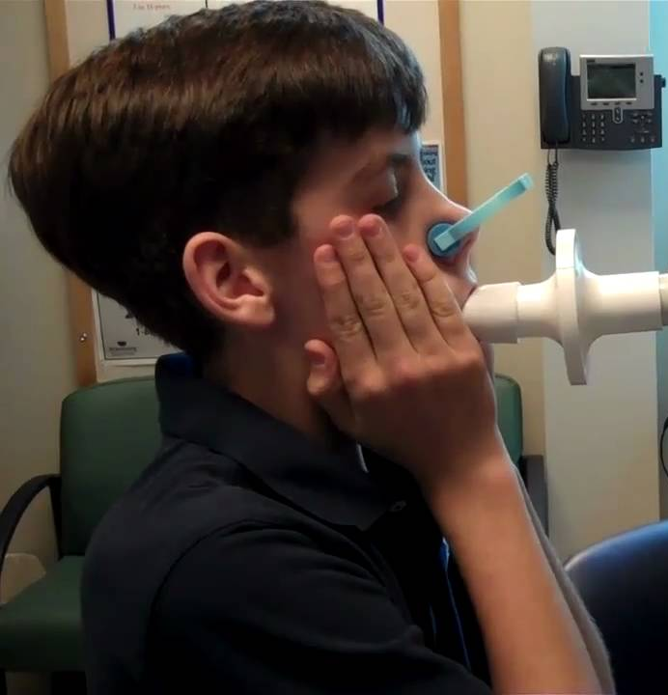
Need
There is no objective, home-based continuous monitoring system for nocturnal asthma
Need ● Scope ● Design Requirements ● Alternatives● Analysis ● Specific Details

Slide 4
Project Scope
We propose to design a commercial, home-based device capable of monitoring symptoms and alerting parents or caregivers if intervention may be required.
Need ● Scope ● Design Requirements ● Alternatives● Analysis ● Specific Details

Slide 5
Project Scope
Not diagnostic
  Intended for children who have been diagnosed with asthma and may suffer from NA
Will not disturb or constrain the child’s sleep
Easy to configure and use
  Manageable by not medically trained audience
Focus on coughs
Need ● Scope ● Design Requirements ● Alternatives● Analysis ● Specific Details

Slide 6
Design Requirements
Specification | Metric
Cost | < $200
Size | W x d x h less than 30 x 30 x 60 cm
Weight | < 3.6 kg
Accuracy | Sensitivity > 70%. Specificity < 2 false coughs/hour
Recording Time | > 12 hours
Sampling Rate | 30 kHz (for audio)
Audio Alert Volume | 0 dB minimum, 80 dB maximum
Transmitter Range | 300 m open field range
Operating Noise | < 30 dB
Need ● Scope ● Design Requirements ● Alternatives● Analysis ● Specific Details

Slide 7
Design Alternatives: Outline
Spirometry
Visual
  Movement detection
  Breathing rate detection
Vibration
  Wearable sensor
  Vibration pad
Pulse Oximetry
Audio
  Wearable sensor
  Bedside sensor
Need ● Scope ● Design Requirements ● Alternatives● Analysis ● Specific Details

Slide 8
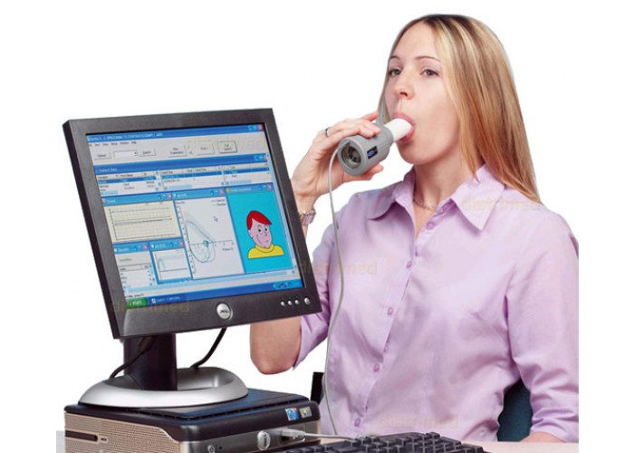
Design Alternatives: Spirometry
Current gold standard
Measures
  Breathing rate
  Respiration volume
Uncomfortable, expensive
Need ● Scope ● Design Requirements ● Alternatives● Analysis ● Specific Details

Slide 9
Design Alternatives: Visual
Movement detection
  Source: Infrared (IR) grid on chest
  Detector: IR camera
  Principal component analysis can compare measurements to model cough
Breathing rate
  Source: Expelled air from child
  Detector: Mid-wave IR camera (“thermal camera”)
  Requires machine learning algorithms—computationally expensive
Need ● Scope ● Design Requirements ● Alternatives● Analysis ● Specific Details

Slide 10
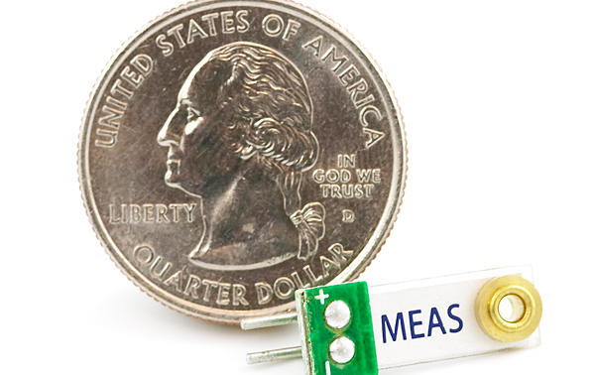
Design Alternatives: Vibration
Wearable sensor
  Placement: collar of shirt
  Detects: sudden movements
Mattress pad
  Placement: grid of 6x6 sensors built into mattress cover
  Detects: sudden movements
Need ● Scope ● Design Requirements ● Alternatives● Analysis ● Specific Details

Slide 11
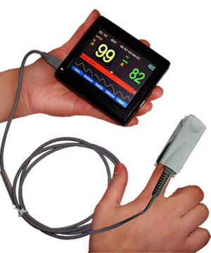
Design Alternatives: Pulse Oximetry
Detects: blood oxygen saturation
  Normal: >95%
  Moderate Hypoxia: 90-95%
  Severe Hypoxia: <90%
Mean-squared error:
  Transmittance: 0.02%
  Reflectance: 2.6%
Need ● Scope ● Design Requirements ● Alternatives● Analysis ● Specific Details

Slide 12
Design Alternatives: Audio
Wearable sensor
  Placement: suprasternal notch
    Below larynx—reduces artifacts
  Detects: coughs and wheezes
Bedside sensor
  Detects: coughs and wheezes
  Unobtrusive
Need ● Scope ● Design Requirements ● Alternatives● Analysis ● Specific Details

Slide 13
Analysis: Pugh Chart
 | Relative importance | Visual: Movement detection | Visual: Breathing rate detection | Vibration: wearable sensor | Vibration: mattress pad | Pulse oximetry: finger clip
Cost | 0.66 | 3 | 1 | 10 | 4 | 9
Safety | 0.66 | 10 | 10 | 8 | 10 | 10
Comfort | 1 | 5 | 5 | 4 | 7 | 5
Ease of use | 1 | 10 | 10 | 7 | 10 | 7
Maintenance | 0.66 | 10 | 10 | 5 | 8 | 8
Size | 0.33 | 5 | 5 | 10 | 5 | 10
Weight | 0.33 | 7 | 7 | 10 | 5 | 10
Recording Time | 0.33 | 10 | 10 | 10 | 10 | 10
Sampling Rate | 0.33 | 10 | 10 | 10 | 10 | 8
Robustness | 1 | 3 | 2 | 4 | 6 | 8
SNR | 0.66 | 6 | 8 | 4 | 4 | 9
Software | 0.66 | 3 | 5 | 8 | 7 | 8
Value of Information | 0.66 | 5 | 8 | 5 | 5 | 3
Range | 1 | 3 | 6 | 10 | 10 | 10
Initial setup | 0.66 | 3 | 3 | 10 | 8 | 8
TOTAL |  | 93 | 100 | 115 | 109 | 123
WEIGHTED TOTAL |  | 57.96 | 63.26 | 71.2 | 73.26 | 78.84
Need ● Scope ● Design Requirements ● Alternatives● Analysis ● Specific Details

Slide 14
Analysis: Pugh Chart
 | Audio: wearable sensor | Audio: bedside sensor | Spirometry | Visual breathing rate & bedside audio | Pulse oximetry & bedside audio | Pulse oximetry & vibration mattress pad
Cost | 8 | 8 | 1 | 1 | 7 | 3
Safety | 8 | 10 | 2 | 10 | 10 | 10
Comfort | 4 | 10 | 1 | 5 | 5 | 5
Ease of use | 7 | 10 | 1 | 10 | 7 | 7
Maintenance | 5 | 10 | 3 | 10 | 8 | 8
Size | 10 | 10 | 4 | 9 | 9 | 5
Weight | 8 | 8 | 4 | 6 | 8 | 5
Recording Time | 10 | 10 | 10 | 10 | 10 | 10
Sampling Rate | 8 | 8 | 10 | 8 | 7 | 8
Robustness | 9 | 9 | 10 | 9 | 9 | 9
SNR | 6 | 7 | 10 | 7 | 9 | 9
Software | 8 | 8 | 6 | 4 | 7 | 6
Value of Information | 8 | 5 | 10 | 9 | 6 | 6
Range | 10 | 8 | 10 | 7 | 8 | 10
Initial setup | 6 | 6 | 5 | 3 | 6 | 8
TOTAL | 115 | 127 | 87 | 108 | 116 | 109
WEIGHTED TOTAL | 74.22 | 84.52 | 55.66 | 70.93 | 75.2 | 73.24
Need ● Scope ● Design Requirements ● Alternatives● Analysis ● Specific Details

Slide 15
Analysis: Vibration
cough slight bend slight bend cough throat clearing
Need ● Scope ● Design Requirements ● Alternatives● Analysis ● Specific Details

Slide 16
Analysis: Audio
The quick brown fox cough jumped over the lazy dog
Need ● Scope ● Design Requirements ● Alternatives● Analysis ● Specific Details

Slide 17
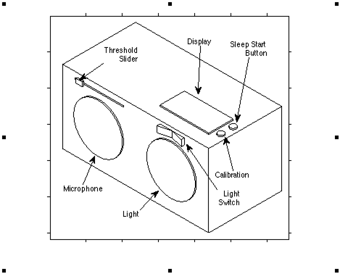
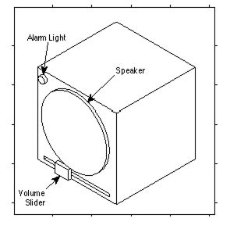
Specific Design Details
Need ● Scope ● Design Requirements ● Alternatives● Analysis ● Specific Details

