Slide 1
A Commercial Nocturnal Asthma Monitor
Group 26: Chris Beyer, William Padovano, David Kim
September 24th, 2014

Slide 2
Why asthma?
In 2006: 300 million asthmatics, growing by 50% every decade¹
8% of adults and 9.3% of children in US in 2010
Costs society billions per year in America alone
Estimates range from 2.3-7.2 billion USD
Asthma is more expensive than HIV/AIDS and tuberculosis combined²
Notes:
“a chronic lung disorder that is marked by recurring episodes of
airway obstruction...manifested by labored breathing accompanied especially by wheezing and
coughing...” – Mirriam Webster
14.2 million doctor’s office visits
1.8 million emergency room visits

Slide 3
Why nocturnal asthma?
What is it?
A marked exacerbation of symptoms at night
47-75% of asthmatics worldwide have NA³
Considered a sign of uncontrolled asthma
No convenient, cheap method of detecting and monitoring NA symptoms
Questionnaires are subjective, thus unreliable⁴
Notes:
In surveys, people often don’t wake up and thus aren’t even conscious of their symptoms. Even if they do wake up, they may simply forget.

Slide 4
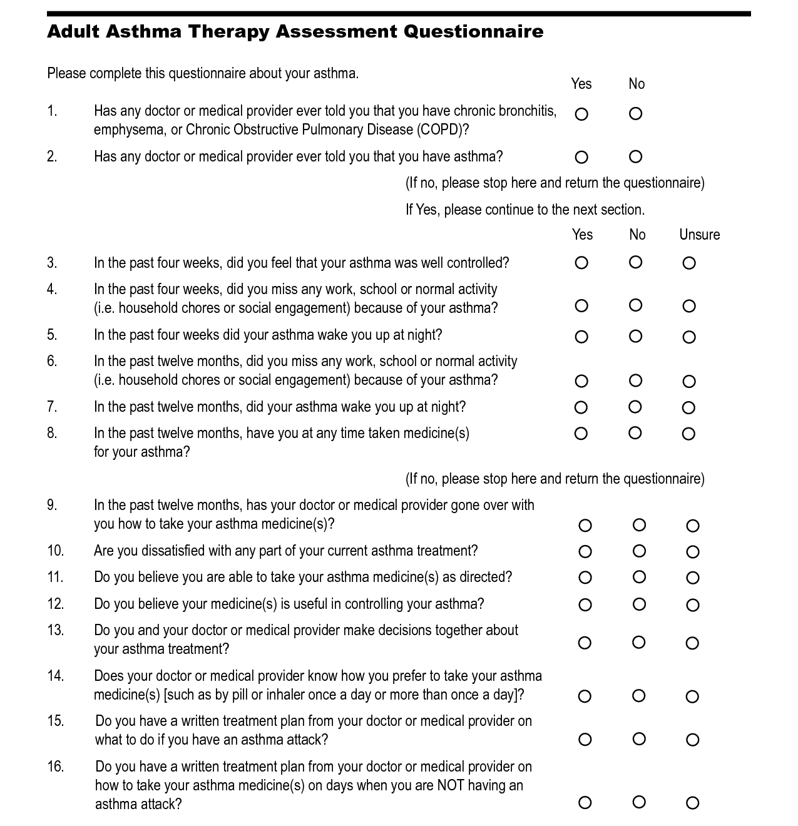
http://img.docstoccdn.com/thumb/orig/98776302.png

Slide 5
Consequences in children
NA causes full awakenings and generally lower quality sleep, causing daytime sleepiness⁵
Significant correlation with depression, anxiety, and poor memory⁶
Also with “developmental, emotional, and behavioral problems”⁷
Increased number of school absences⁸
Notes:
Know more details about all of this stuff
Especially since 80% of respiratory arrests and 70% of deaths due to asthma happen at night, there is a clear need for a device to monitor symptoms at home. Not only to keep track of NA and ensure that it’s under control, but to alert a caregiver in the case of an attack.
-> know the unmber of deaths

Slide 6
The unidentified monster in the bed
Survey of 13,493 asthmatics found that only 48% knew their true NA status
42% of those who said they didn’t, actually did ³
Applies specifically to children
“less than 40% of parents…report their child’s NA symptoms appropriately.”³
80% of respiratory arrests and 70% of deaths caused by asthma occur at night^{9,10}

Slide 7
The Need
There is no objective, home-based continuous monitoring system for nocturnal asthma.
Background ● Need ● Scope ● Specifications ● Solutions ● Analyses ● Schedule ● Responsibilities

Slide 8
Project Scope
We propose to design a commercial, home-based device capable of monitoring symptoms and alerting parents or caregivers if intervention may be required.
Background ● Need ● Scope ● Specifications ● Solutions ● Analyses ● Schedule ● Responsibilities

Slide 9
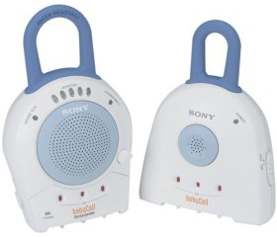
Project Scope
Not diagnostic
Intended for children who have been diagnosed with asthma and may suffer from NA
Will not disturb or constrain the child’s sleep
Easy to configure and use
Coughs are the focus
http://www.martinrothonline.com/personalhealthmonitor/images/Sony%20BabyCall.jpg
Background ● Need ● Scope ● Specifications ● Solutions ● Analyses ● Schedule ● Responsibilities

Slide 10
Design Specifications
Cost: < $100
Size: < 12” x 12” x 24”
Weight: < 8 lbs
Accuracy: Must recognize at least 70% of coughs. Can only falsely recognize up to 2 coughs per hour¹¹
Operating time: 12 hours
Background ● Need ● Scope ● Specifications ● Solutions ● Analyses ● Schedule ● Responsibilities

Slide 11
Design Specifications
Sampling rate: at least 48 kHz
Audible alert volume: variable, 0-80 dB
Transmitter range: Open field range ≥ 1,500 ft.
Operating noise: ≤ 30 dB
Background ● Need ● Scope ● Specifications ● Solutions ● Analyses ● Schedule ● Responsibilities

Slide 12
Existing Solutions - Spirometry
Longtime standard for clinical diagnosis and characterization of asthma
Measures lung capacity and flow velocities
Performed by patients at home?
Diurnal spirometry has been shown to be “not clinically useful,”³
Not continuous
http://www.carefusion.com/Images/Respiratory/Pulmonary_Function_Testing/IOS_Impulse.jpg
Background ● Need ● Scope ● Specifications ● Solutions ● Analyses ● Schedule ● Responsibilities

Slide 13
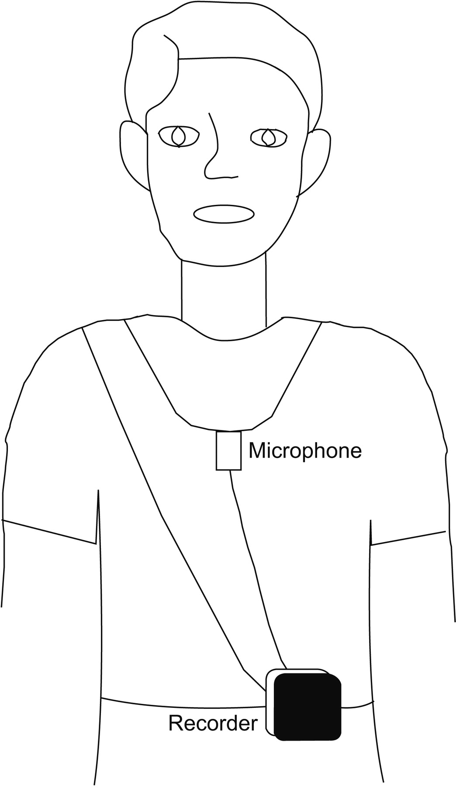
Clinical Solutions
Require clinicians to operate or interpret¹²
Can disturb sleep
Wires, sensors = constrained patient¹³
5 researched monitors:
HACC
LifeShirt
LCM
LR-100
Self-contained monitor
http://erj.ersjournals.com/content/31/5/1013/F1.large.jpg
Background ● Need ● Scope ● Specifications ● Solutions ● Analyses ● Schedule ● Responsibilities
Notes:
They use EEG, EMG, accelerometers, etc. Most use audio, at least in part.

Slide 14
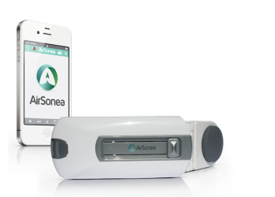
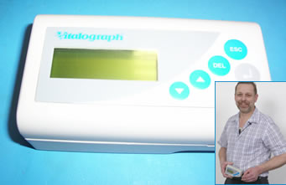
Commercial Solutions
AirSonea
Two continuous-monitoring, at-home solutions
VitaloJAK
ADAM
http://isonea.com/wp-content/uploads/2013/03/airsonea-composite-trans.png
http://vitalograph.com/content/images/news/vitalojak-wins-north-west-nhs-innovation-award.jpg
Background ● Need ● Scope ● Specifications ● Solutions ● Analyses ● Schedule ● Responsibilities
Notes:
Overwhelming majority of devices monitor coughs
HACC: Requires manual review by clinician. 80%, not real time, overnight in lab setting
LifeShirt: Plethysmography, ECG, EMG. < 80% sensitivity, pulled from market
LCM: microphone necklace. Time series recognition a la SR. Median sensitivity of 86%, median fp rate of .8/hr.
LR-100: Microphone, EMG. Four sensors on the chest, slightly overestimates
Self-contained monitor: accelerometer on the throat, .998 concordance correlation coefficient for audio counts, but only 15-60 minute ambulatory recordings

Slide 15
Patent Search
Many suffer from the same problems
Use signals which require wires and electrodes, have a wearable sensor (necklace)
Others, while “mobile”, require a paired smartphone, computer
Background ● Need ● Scope ● Specifications ● Solutions ● Analyses ● Schedule ● Responsibilities

Slide 16
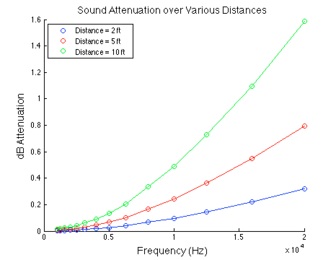
Preliminary Analysis – Attenuation
Sample calculation:
At 1kHz tone at a distance of 5ft:
dB/km = 4.7 attenuation per length (retrieved from chart)
dB = (4.7dB/km) * (1km/1000m) * (1m/3.28ft) *( 5ft)
dB = 0.0072 attenuation
Data from:
The speed and attenuation of sound 2.4.1. (n.d.). Retrieved September 17, 2014, from http://www.kayelaby.npl.co.uk/general_physics/2_4/2_4_1.html
Background ● Need ● Scope ● Specifications ● Solutions ● Analyses ● Schedule ● Responsibilities

Slide 17
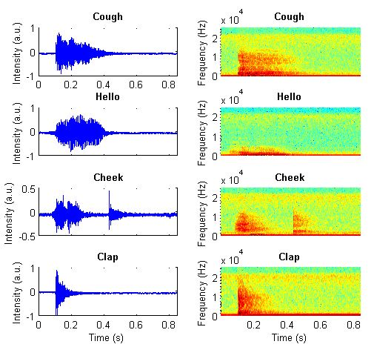
Preliminary Analyses – STFTs
Sampling rate: 96,000 Hz.
Window size: 256
Nfft: 256
Overlap: 128.
Background ● Need ● Scope ● Specifications ● Solutions ● Analyses ● Schedule ● Responsibilities

Slide 18
Preliminary Analysis – Varying Volume
Background ● Need ● Scope ● Specifications ● Solutions ● Analyses ● Schedule ● Responsibilities

Slide 19
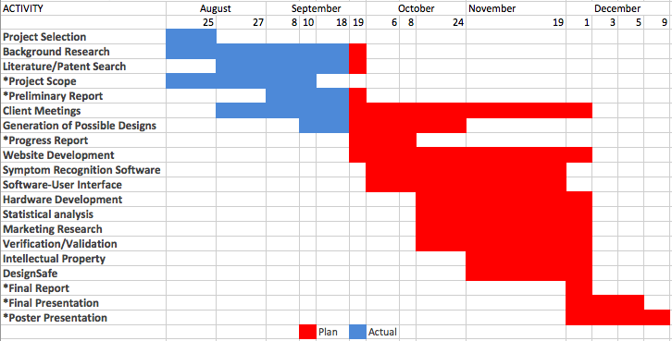
Preliminary Design Schedule
Background ● Need ● Scope ● Specifications ● Solutions ● Analyses ● Schedule ● Responsibilities

Slide 20
Preliminary Team Responsibilities
Task | Chris Beyer | David Kim | William Padovano
Background research
Literature/patent search
Marketing research
Project scope
Project selection
Symptom recognition software
Software user interface
Hardware (including sensors)
Statistical analysis
Website
Intellectual property
Preliminary report
Progress report
Final report
Background ● Need ● Scope ● Specifications ● Solutions ● Analyses ● Schedule ● Responsibilities

Slide 21
Questions?

Slide 22
References
Braman, S. S. (2006). The global burden of asthma. Chest Journal,130(1_suppl), 4S-12S
Bahadori, K., Doyle-Waters, M. M., Marra, C., Lynd, L., Alasaly, K., Swiston, J., & FitzGerald, J. M. (2009). Economic burden of asthma: a systematic review. BMC pulmonary medicine, 9(1), 24.
Ginsberg, D. (2009). An Unidentified Monster in the Bed– Assessing Nocturnal Asthma in Children. McGill Journal of Medicine: MJM, 12(1), 31.

Slide 23
References
Mallol, J., & Castro‐Rodríguez, J. A. (2006). Differences in prevalence of asthma, rhinitis, and eczema between parental and self‐completed questionnaires in adolescents. Pediatric pulmonology, 41(5), 482-487.
Chugh IM, Khanna P, Shah A. Nocturnal symptoms and sleep disturbances in clinically stable asthmatic children. Asian Pacific journal of allergy and immunology / launched by the Allergy and Immunology Society of Thailand. 2006 Jun–Sep;24:2–3. 135–42.
Stores G, Ellis AJ, Wiggs L, et al. Sleep and psychological disturbance in nocturnal asthma. Archives of disease in childhood. 1998 May;78(5):413–9.

Slide 24
References
Bentur L., Beck, R., et al. Wheeze monitoring in children for assessment of nocturnal asthma and response to therapy. European Respiratory Journal 2003; 21: 621-26.
Diette GB, Markson L, Skinner EA, et al. Nocturnal asthma in children affects school attendance, school performance, and parents' work attendance. Archives of pediatrics & adolescent medicine. 2000 Sep;154(9):923–8.
Asthma: analysis of sudden deaths and ventilatory arrests in hospital. Hetzel MR, Clark TJ, Branthwaite MA. Br Med J. 1977 Mar 26; 1(6064):808-11.
Nocturnal asthma. Calhoun WJ. Chest. 2003 Mar; 123(3 Suppl):399S-405S.

Slide 25
References
Rhee, Hyekyun, et al. "The development of an automated device for asthma monitoring for adolescents: Methodologic approach and user acceptability.“ JMIR mHealth and uHealth 2.2 (2014).
Leconte S., Ferrant D., et al. Validated mthods of cough assessment: a systematic review of the literature. Resipiration 2011; 81(2):161-74.
McCrory DC, Coeytaux RR., et al. Assessment and Management of Chronic Cough. Agency for Healthcare Research and Quality 2013; Report No. 13-EHCO32-EF.

